Slide 1
Multimodal Audio Analysis for Early Brain Disorder Detection
Presented by
1.Manoj Jegan D (722822106073)
2.Mehaa C E (722822106076)
3.Pavithra R (722822106103)
4.Rekashini G (722822106123)
Guided by
Ms.T.Nivethitha
Assistant professor
Department of ECE
Sri Eshwar College of Engineering.
Notes:
Don’t include any decorative contents ( images , animations , sounds etc..)
Don’t change background in to different colors.
Ensure that date of presentation & batch number is updated before sending this ppt.

Slide 2
Presentation Outline
  Introduction
  Abstract
  Block Diagram
  Explanation
  Objective
  Methodology
  Expected Outcome
  References
18-11-2025
Notes:
This order can be varied based on the project Domain

Slide 3
AREA OF THE PROJECT:
  Artificial Intelligence (AI) in Healthcare
  Biomedical Signal Processing (Speech & Breathing Analysis)
  Machine Learning for Neurological Disorder Detection
  Audio Feature Extraction and Pattern Recognition
  Early Diagnosis Support Systems using Non-Invasive Techniques
Notes:
This order can be varied based on the project Domain

Slide 4
FIELD OF THE PROJECT:
Health Informatics
Artificial Intelligence and Machine Learning
Biomedical Engineering
Speech and Audio Signal Processing
Neurological Disorder Screening and Diagnosis
Notes:
This order can be varied based on the project Domain

Slide 5
Literature Survey
Paper Title | Journal details | Methodology | Disadvantages
1.Suitability Dysphonia Measurements for Telemonitoring of Parkinsons Disease. | IEEE Transactions on Biomedical Engineering, Vol. 56, No. 4, 2009 | Used traditional and novel voice measures with feature selection and kernel SVM to classify PD vs healthy voices. | Advantage: High accuracy and robust to voice variations for telemonitoring Disadvantage: Some measures fail with noisy non-repetitive speech.
2. Analysis of Parkinson’s and Alzheimer’s Disease Using Various Machine Learning Based Algorithm | 2024 3rd International Conference on Artificial Intelligence For Internet of Things (AIIoT), IEEE, 2024 | Build ML models (XGBoost, Decision Tree, Random Forest, SVM, KNN) to diagnose Alzheimer’s and Parkinson’s using patient parameters. | Advantage: Enables early detection and supports timely treatment planning. Disadvantage:Accuracy depends on quality and size of available medical data.
3.A novel GA-ELM approach for Parkinson's disease detection using brain structural T1-weighted MRI data. | 2016 Second International Conference on Cognitive Computing and Information Processing (CCIP), IEEE, 2016 | Collected breathing sounds extracted audio features, selected significant features as acoustic biomarkers. | Advantage: Achieved high accuracy enabling potential smartphone-based screening. Disadvantage: Performance affected by uncontrolled home environments.
Notes:
A minimum of 8 journal papers to be used. (select papers from the Journals like IEEE, Springer, Elsevier, Wiley)
Paper details : title of the paper
Journal Detail : Name of the journal , year , volume no , issue no
Methodology : Technique , Algorithm, Domain etc…

Slide 6
Literature Survey
Paper Title | Journal details | Methodology | Disadvantages
4.LSTM Neural Network for Parkinson’s Disease Analysis | 2022 8th International Conference on Contemporary Information Technology and Mathematics (ICCITM), IEEE, 2022 | Trained an LSTM model on PD data and compared it with traditional ML methods. | Advantages: Achieved very high accuracy (99%) in PD diagnosis. Disadvantages: Requires large, high-quality datasets for reliable performance.
5.Wearable multimodal sensors for evaluation of patients with Parkinson disease | 2015 IEEE International Conference on Control System, Computing and Engineering (ICCSCE), IEEE, 2015 | Collected motion data via triaxial wearable sensors and classified it using time/frequency features with 10-fold cross-validation. | Advantage: Achieved >88% accuracy, sensitivity, specificity, and ROC in PD detection. Disadvantage: Multiple sensors may cause discomfort and limit adoption.
6.A Review on Parkinson’s Disease Detection Using Non-Invasive Procedures | IEEE Access, Vol. 13, 2025 | Reviewed 2019–2024 PD studies on features, reduction, selection, classification, datasets, and tools. | Advantage: Consolidates up-to-date techniques and tools for PD research. Disadvantage: Does not propose or test a new detection model.
Notes:
A minimum of 8 journal papers to be used. (select papers from the Journals like IEEE, Springer, Elsevier, Wiley)
Paper details : title of the paper
Journal Detail : Name of the journal , year , volume no , issue no
Methodology : Technique , Algorithm, Domain etc…

Slide 7
EXISTING SYSTEM:
Current diagnosis of Alzheimer’s and Parkinson’s typically depends on clinical assessments, imaging, or invasive procedures.
Recent AI approaches leverage speech features such as MFCC, jitter, and shimmer for early detection. Datasets target Alzheimer’s detection using spontaneous speech tasks, while Parkinson’s detection often uses sustained vowel phonation and prosodic voice features.
However, no existing system integrates both speech and sleep breathing audio for dual detection of these disorders, presenting a unique research opportunity.
Notes:
Discuss about the problem statement identified in your project and their solutions (not in paragraphs ….only bulletins )

Slide 8
MOTIVATION
Alzheimer’s and Parkinson’s are hard to detect early
• Current diagnostic methods are costly, invasive, and time-consuming.
• Many patients lack access to advanced medical facilities.
• AI with audio analysis offers a simple, affordable, and non-invasive alternative.
• Early detection can improve quality of life and enable timely medical intervention.
Notes:
Mention the Motivation statement ….(what is your project work in statements …….not in paragraph ………only bulletin points

Slide 9
Objective
Build an AI model to:
Detect early signs of Alzheimer’s and Parkinson’s.
Identify the most predictive audio features (e.g., pitch irregularity, pause duration).
Enable screening using accessible devices like smartphones.
Reduce the need for costly or invasive clinical procedures.
Assist healthcare professionals in early intervention and monitoring
Notes:
Mention the Objective statement ….(what is your project work in statements …….not in paragraph ………only bulletin points)

Slide 10
Introduction
Neurological diseases often remain unnoticed until they affect daily life
System analyzes speech, voice, and breathing patterns captured through smartphones
Signal processing and AI-based feature extraction used to study sound quality and speech patterns
Enables large-scale, accessible, and cost-effective early screening and continuous monitoring
Notes:
About the Introduction of your project

Slide 11
Abstract
Method for early detection of Alzheimer’s and Parkinson’s using speech, breathing, and voice analysis
Audio captured via smartphone and processed for features like MFCCs, jitter, and shimmer
Machine learning models (CNN, LSTM, Random Forest, XGBoost) classify Healthy, Alzheimer, and Parkinson cases
Provides real-time risk assessment and continuous monitoring through smartphone-based application
Notes:
Discuss about the Abstract identified in your project and their solutions (not in paragraphs ….only bulletins )

Slide 12
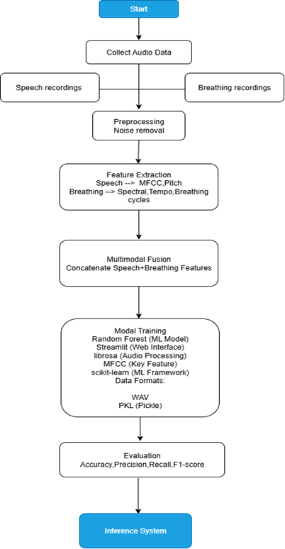
Block Diagram
Notes:
Explain about the Block Diagram of the Project

Slide 13
Explanation
NeuroListen is an AI-driven voice analysis system designed to detect early signs of Alzheimer’s and Parkinson’s diseases through speech.
It uses advanced machine learning models to analyze voice features such as frequency, tone, and jitter-shimmer patterns, which often reflect neurodegenerative conditions.
The goal is to enable non-invasive, early diagnosis using just a simple audio recording.
Frontend: Built with Streamlit, allowing users to upload voice samples and view predictions and feature reports.
Backend: Uses Python (Librosa, Scikit-learn, Pandas) for signal processing, feature extraction, and model inference.
Model: Pre-trained Random Forest / Decision Tree classifier trained on voice datasets with extracted features like MFCCs, Deltas, Jitter, and Shimmer.
Output: Displays prediction results, probability graphs, and generates a downloadable PDF report summarizing extracted features.
Notes:
Explain about the proposed work

Slide 14
Hardware / Software Details
Software
Python with Librosa, TensorFlow/Keras
Tools: Jupyter Notebook, Audacity
ML models: CNN, LSTM, 1D-CNN
Hardware
Microphone / Smartphone for recording
Laptop/PC for training
Notes:
Provide Hardware / Software Details

Slide 15
Methodology for the Proposed work
Collect and preprocess voice recordings from users to remove background noise and normalize audio.
Extract key speech features such as MFCCs, jitter, shimmer, pitch, and spectral centroid using Librosa.
Train machine learning models like CNN, LSTM, Random Forest, and Decision Tree for accurate disease detection.
Implement a Streamlit-based user interface for easy audio upload, analysis, and visualization.
Evaluate system performance using metrics such as accuracy, precision, recall, and F1-score to ensure reliability.
Continuously update the model using new data samples to improve adaptability and accuracy.
Notes:
Project work flow

Slide 16
Methodology for the Proposed work
The system effectively detects early signs of Alzheimer’s and Parkinson’s with high accuracy.
Visual confidence graphs and reports help doctors interpret results clearly.
The interface supports real-time, remote screening, aiding telemedicine.
Integration of deep learning (CNN/RNN) can further improve performance.
Expansion to multi-language and large datasets will increase robustness.
Future versions will include mobile app and IoT connectivity for continuous monitoring.
Plans to include privacy-preserving techniques like federated learning for secure model improvement.
Notes:
Project work flow

Slide 17
Methodology for the Proposed work
Non-invasive and affordable alternative to traditional diagnostic tests.
Quick and user-friendly — suitable for both doctors and patients.
Portable and scalable for large-scale community health screening.
Enables continuous health monitoring from home.
Supports data-driven decision-making in neurological research and healthcare.
Notes:
Project work flow

Slide 18
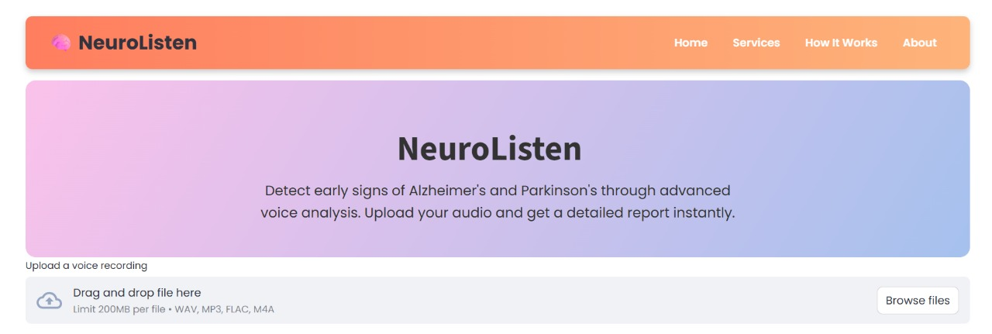
Expected Outcome
Notes:
Discuss about the Expected results from the Project

Slide 19
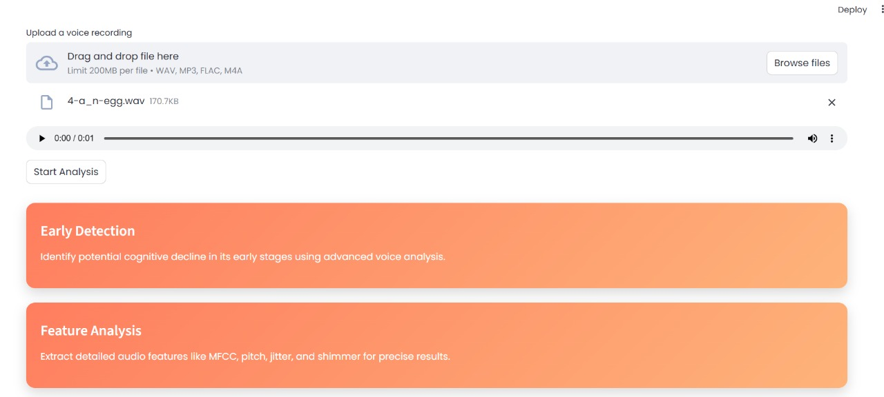
Expected Outcome
Notes:
Discuss about the Expected results from the Project

Slide 20
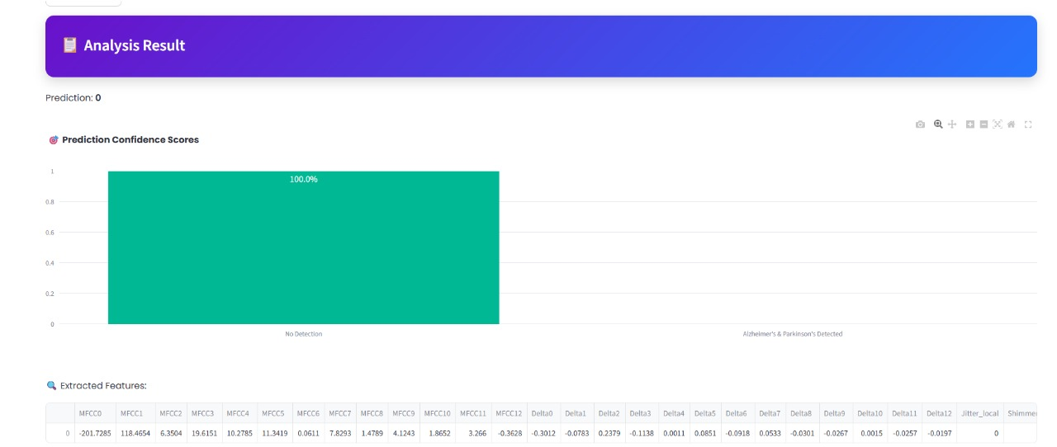
Expected Outcome
Notes:
Discuss about the Expected results from the Project

Slide 21
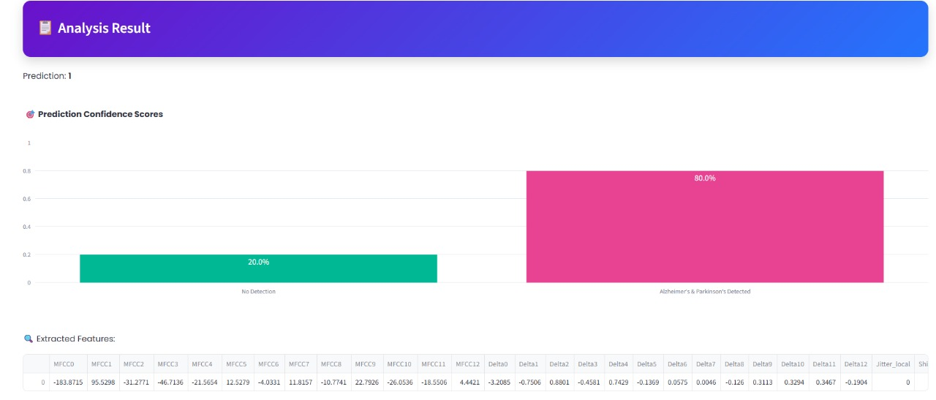
Expected Outcome
Notes:
Discuss about the Expected results from the Project

Slide 22
Execution Plan
First review -- Software 25% completion
Second review – Software 50%Completion
Final review –Software100%completion
Notes:
Phase 1 – H/w purchase ( 1st Review )
Phase 2 – S/w simulation ( 2nd Review )
Phase 3 – Demonstration with Report ( Final Review )

Slide 23
References
[1] Nithiyameenatchi, N., Rajkumar, S., Konguvel, E., Narayan, M. A., & Balaji, B. (2024). Analysis of Parkinson’s and Alzheimer’s Disease Using Various Machine Learning Based Algorithm. 2024 3rd International Conference on Artificial Intelligence For Internet of Things (AIIoT). IEEE.
[2] Little, M. A., McSharry, P. E., Hunter, E. J., Spielman, J., & Ramig, L. O. (2009). Suitability of dysphonia measurements for telemonitoring of Parkinson’s disease. IEEE Transactions on Biomedical Engineering, 56(4), 1015–1022.
[3] Zhang, Y., Jin, Y., Chen, G., Ma, Y., Jia, M., & Song, P. (2025). Using Corrected ASR Projection to Improve AD Recognition Performance from Spontaneous Speech. ICASSP 2025 - 2025 IEEE International Conference on Acoustics, Speech and Signal Processing (ICASSP). IEEE.
[4] Patro, P., & Das, T. K. (2025). Artificial Intelligence in Action (2019-2024): A Review on Parkinson’s Disease Detection Using Non-Invasive Procedures. IEEE Access, 13. IEEE.
[5]Pahuja, G., & Nagabhushan, T. N. (2016). A novel GA-ELM approach for Parkinson's disease detection using brain structural T1-weighted MRI data. 2016 Second International Conference on Cognitive Computing and Information Processing (CCIP). IEEE.
Notes:
Phase 1 – H/w purchase ( 1st Review )
Phase 2 – S/w simulation ( 2nd Review )
Phase 3 – Demonstration with Report ( Final Review )

Slide 24

